Slide 1


Slide 2
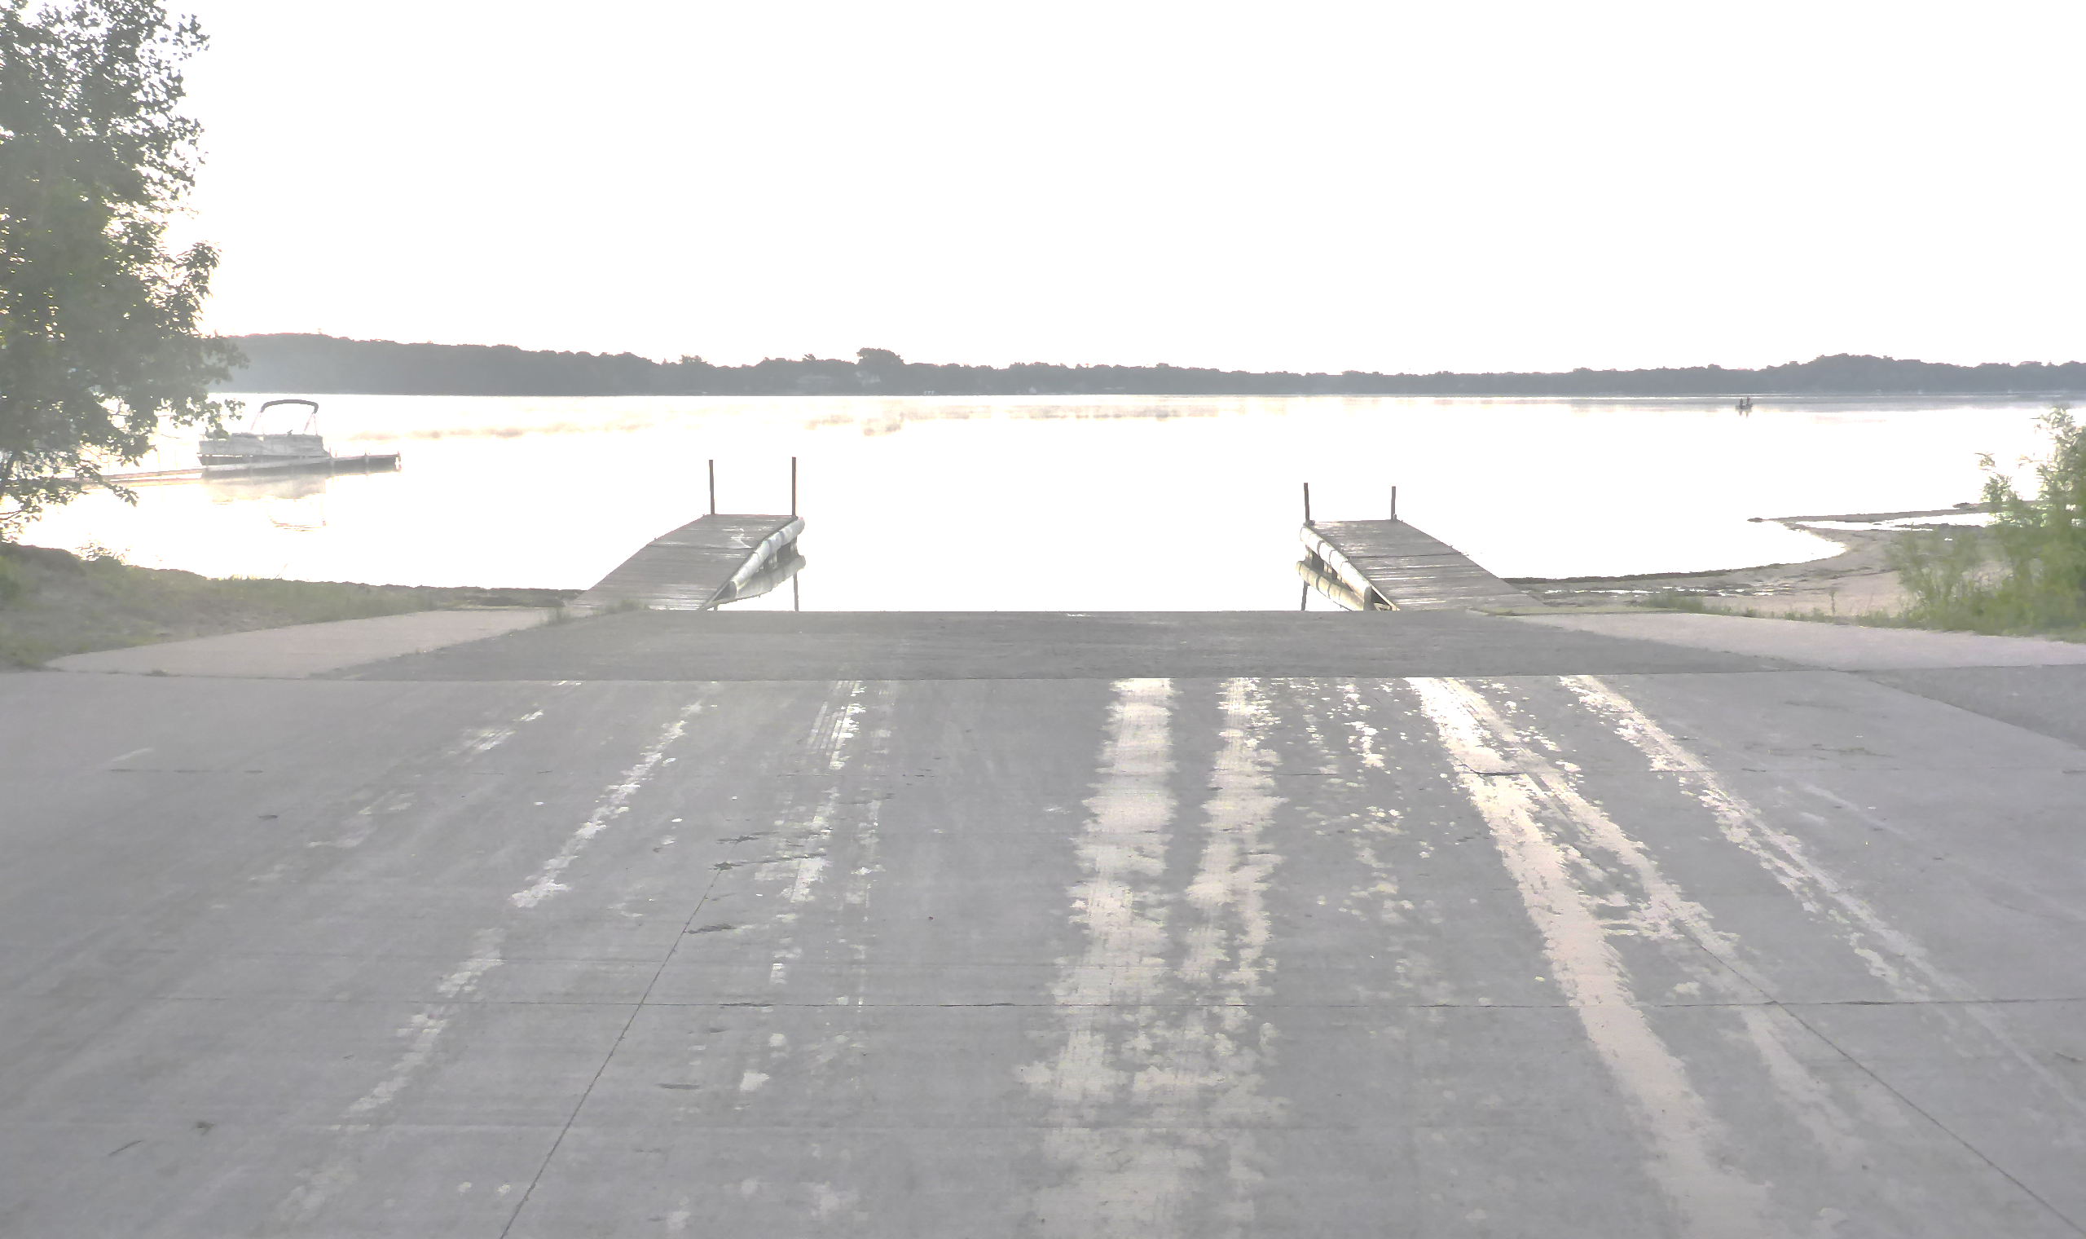
White Bear Lake Water Quality and Lake Use Study 2024
Steve McComas
Blue Water Science
January 27, 2026

Slide 3
White Bear Lake Data Summary and Trend Analysis Through 2024

Slide 4
Water Quality Reviewed in the Trend Analyses
Lake and Watershed Characteristics
Lake Levels and Weather Data
Water Quality Indicators
Secchi disc
Total phosphorus
Chlorophyll a
Chloride
Aquatic Plants and Zebra Mussels
Fish

Slide 5
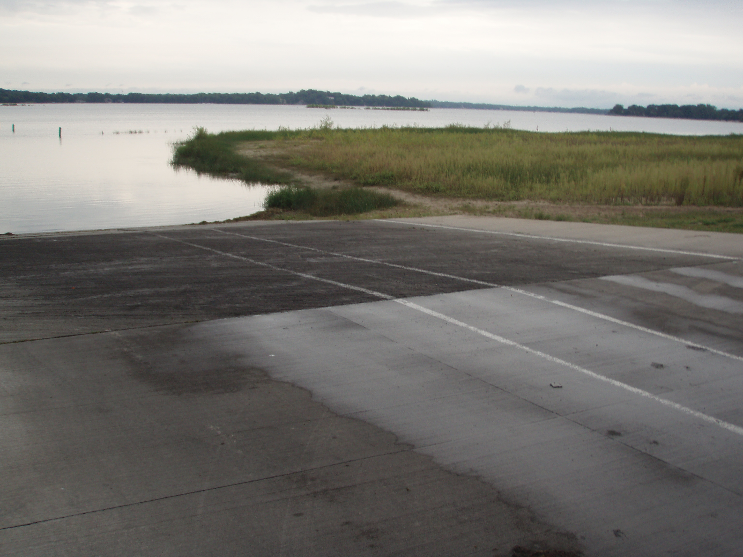
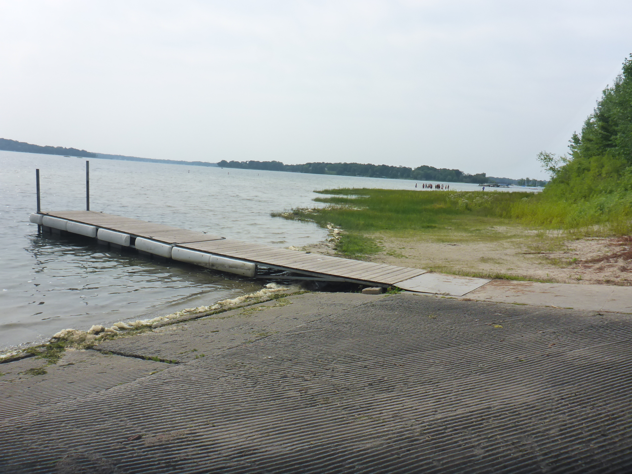
WBL Lake Levels Have Fluctuated Over the Years
County Access, 2011 County Access, 2024

Slide 6
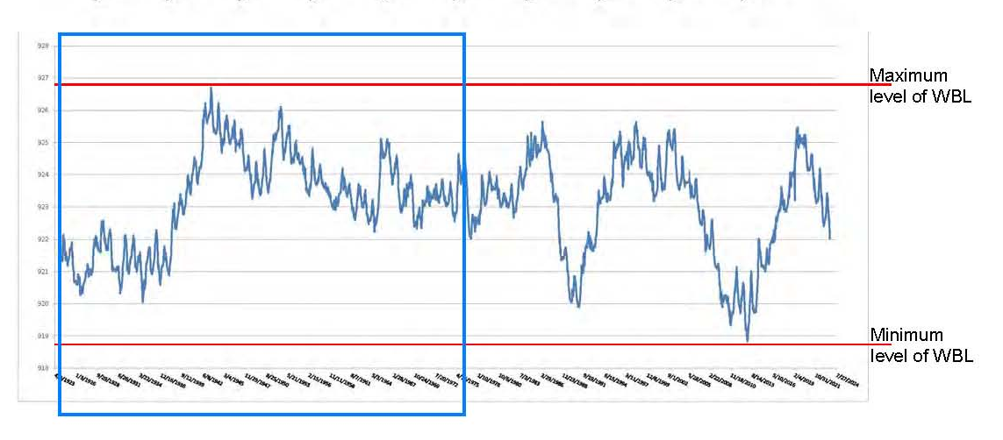
WBL Lake Levels from 1923 – 2024 (Rainfall and evapotranspiration are factors)
Well augmentation years
1923 1988 2010 2024

Slide 7
Four Water Quality Parameters Have a Long Record
Parameter | Trend | Length of Data Base (4 or more readings/year)
Secchi disc (clarity) | increase | 70 years
Total phosphorus | decrease | 70 years
Chlorophyll a (algae) | decrease | 54 years
Chloride | increase | 70 years

Slide 8
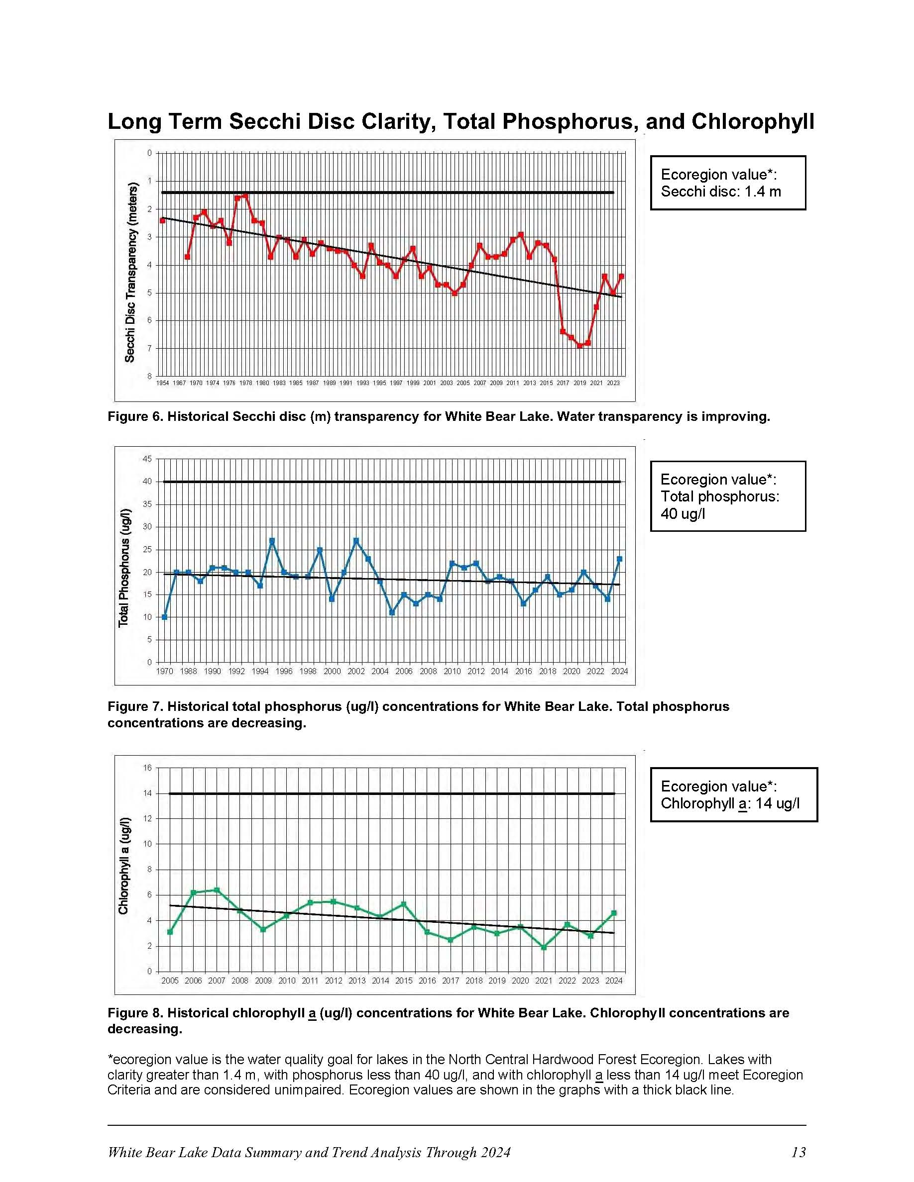
Long Term Secchi Disc Clarity
Secchi disc clarity less than 1.4 m is impaired.

Slide 9
Long Term Total Phosphorus (Nutrients)
Phosphorus greater than 40 ug/l is impaired.

Slide 10
Long Term Chlorophyll a (algae)
Chlorophyll greater than 14 ug/l is impaired.

Slide 11
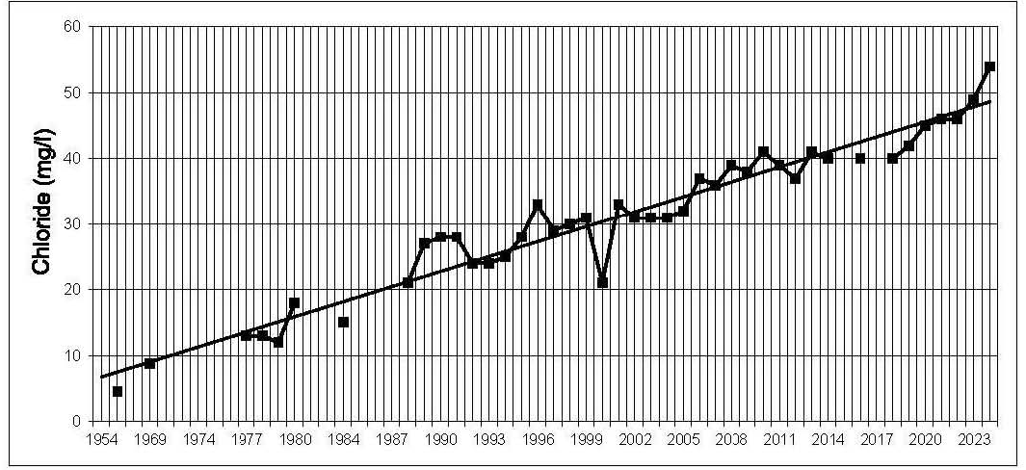
Long Term Chlorides
Chloride >240 mg/l is an impaired water. WBL is at 55 mg/l.

Slide 12
Aquatic Plant Summary for 1972-2023 Based on Plant Transect Surveys
Year | Number of Species | Dominant Species
1972 | 18 | Flatstem pondweed
1984 | 8 | Coontail & Milfoil
1989 | 15 | Naiads
1997 | 16 | Claspingleaf pondweed
1998 | 20 | Eurasian watermilfoil
1999 | 21 | Coontail
2000 | 20 | Eurasian watermilfoil
2001 | 24 | Eurasian watermilfoil
2002 | 21 | Eurasian watermilfoil
2003 | 18 | Eurasian watermilfoil
Year | Number of Species | Dominant Species
2004 | 21 | Eurasian watermilfoil
2005 | 25 | Eurasian watermilfoil
2006 | 23 | Eurasian watermilfoil
2007 | 22 | Eurasian watermilfoil
2008 | 17 | Eurasian watermilfoil
2009 | 21 | Eurasian watermilfoil
2010 | 18 | Coontail
2011* | 19 | Coontail
2023 | 24 | Naiads
*2012-2022: no surveys

Slide 13
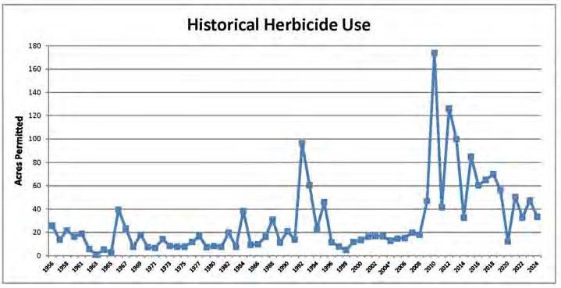
Aquatic Plant Management (EWM first observed in 1988)
Low Lake Levels
Native Plant Treatments
Aggressive EWM Control
1988

Slide 14
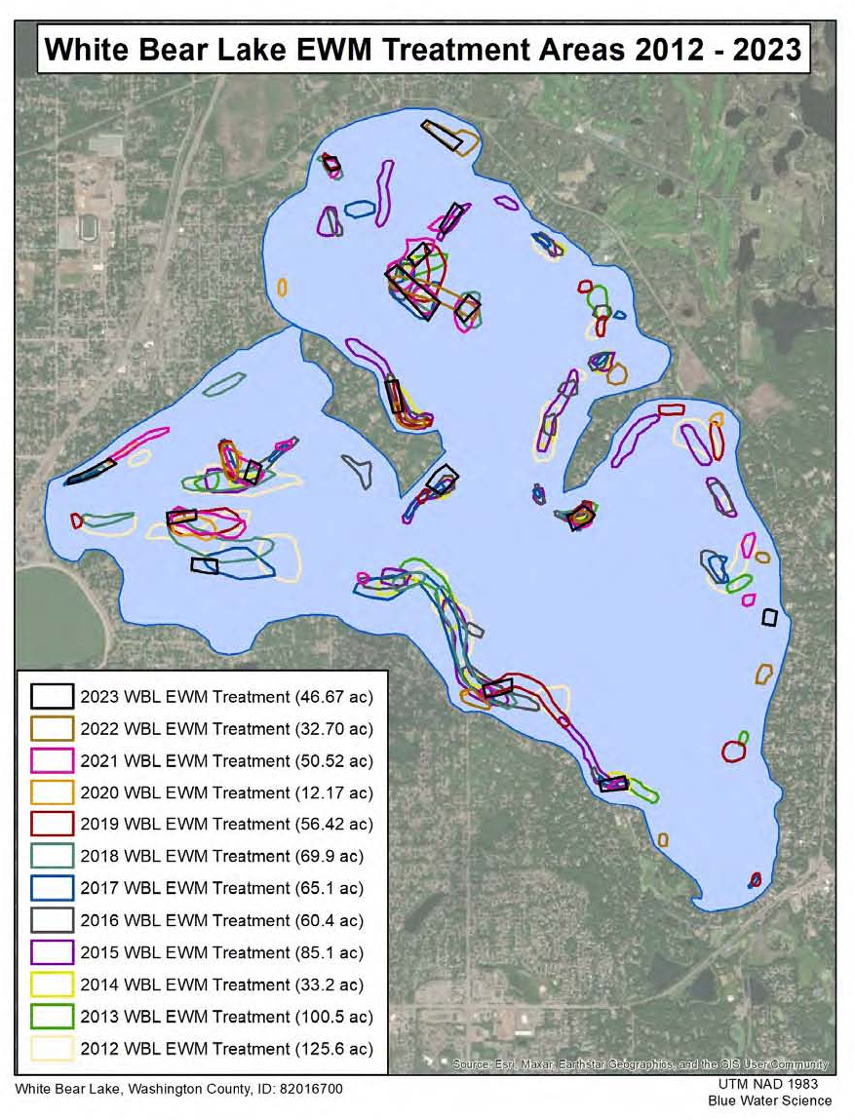
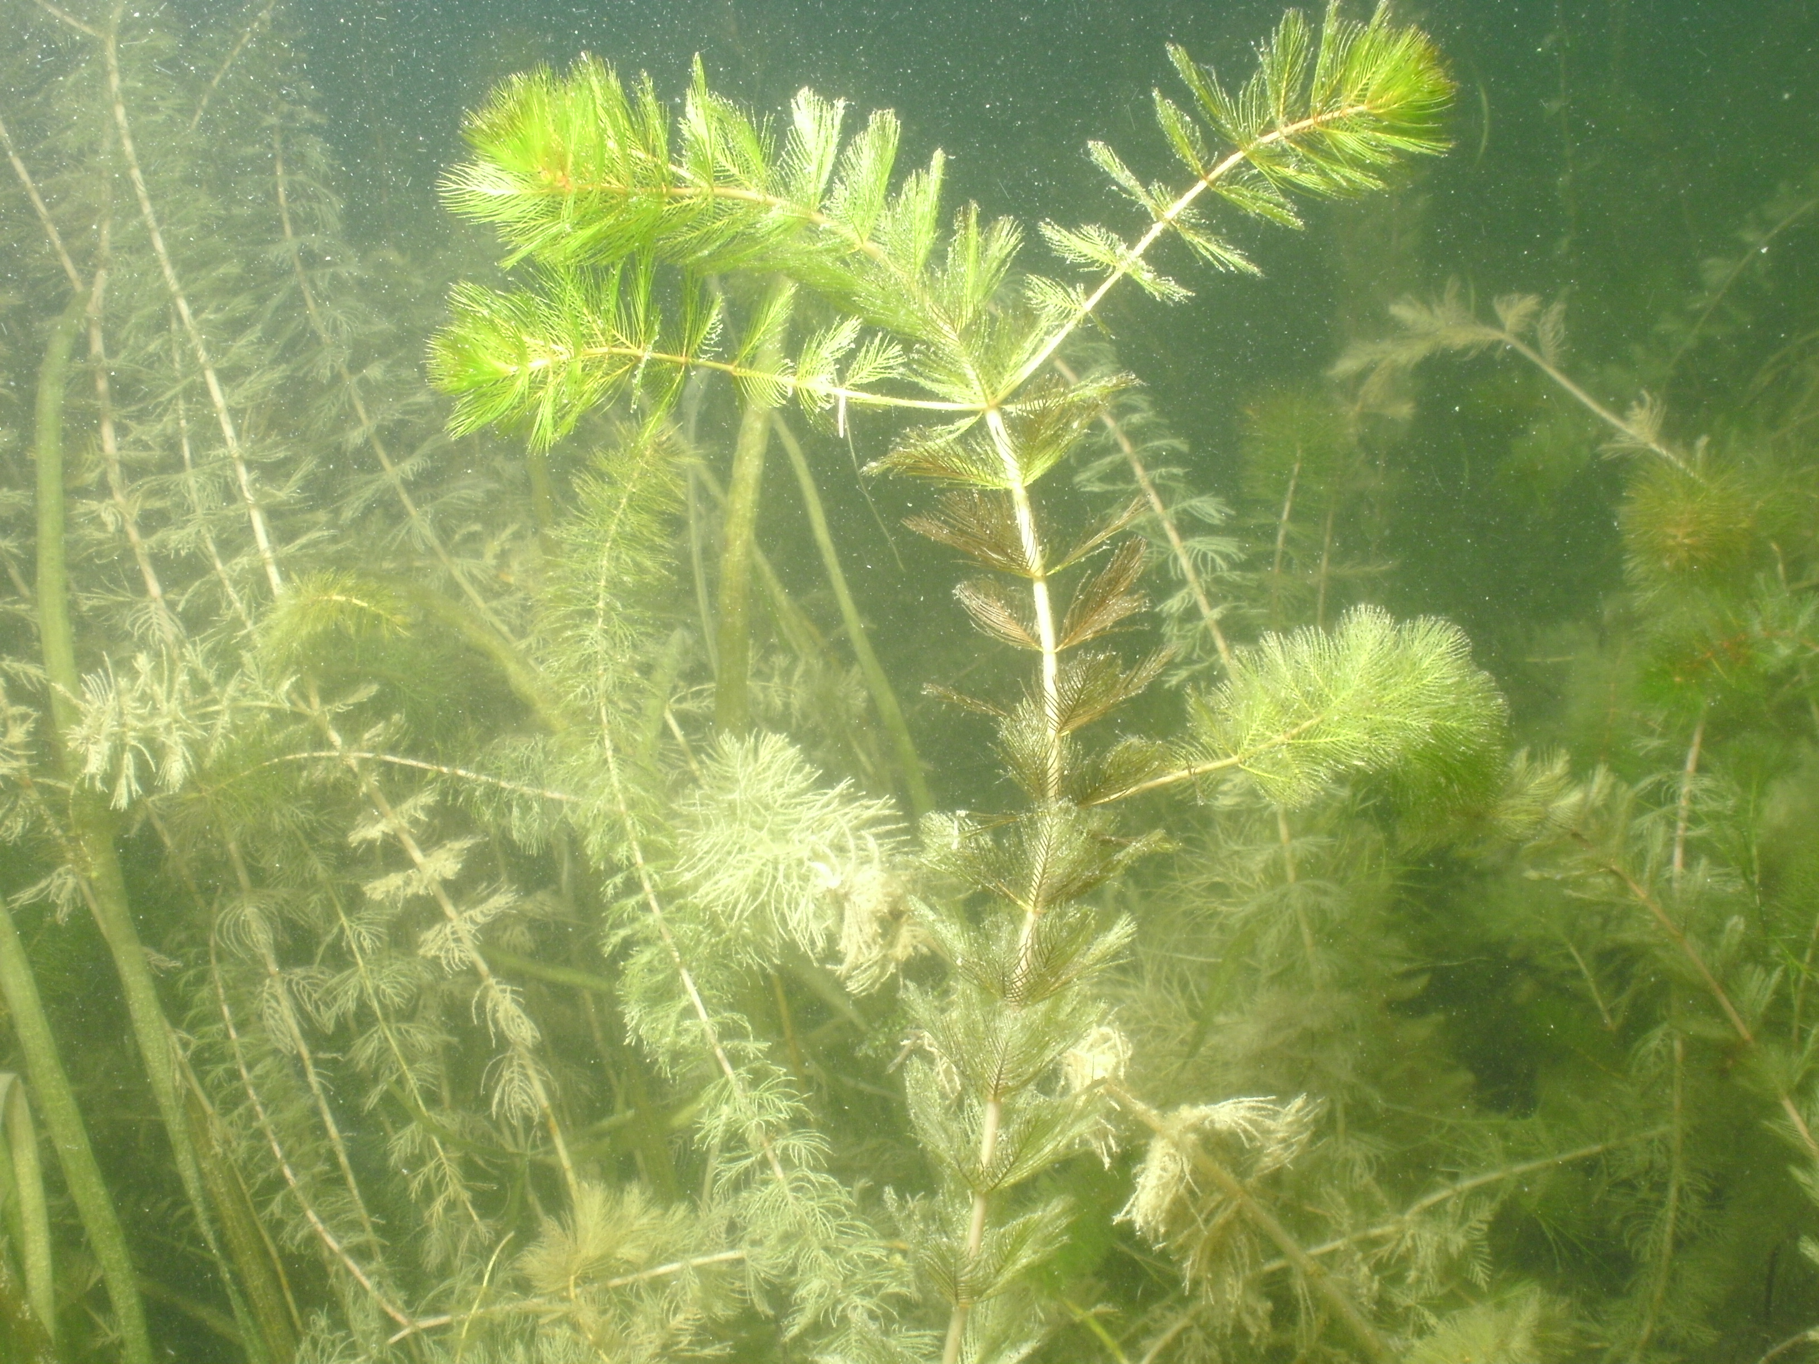
EWM First Observed in 1988

Slide 15
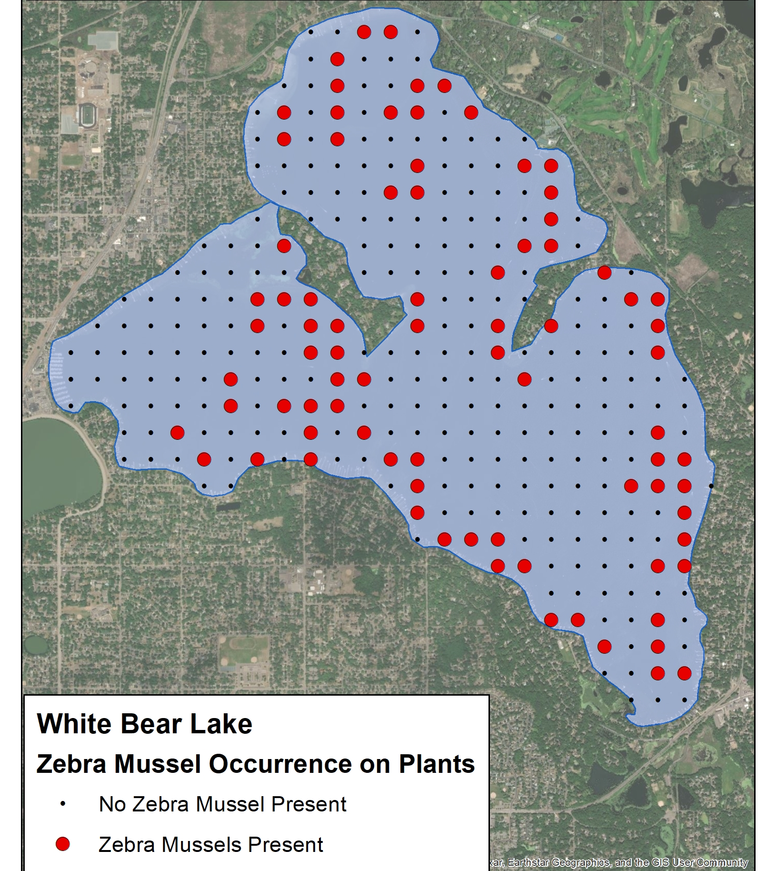
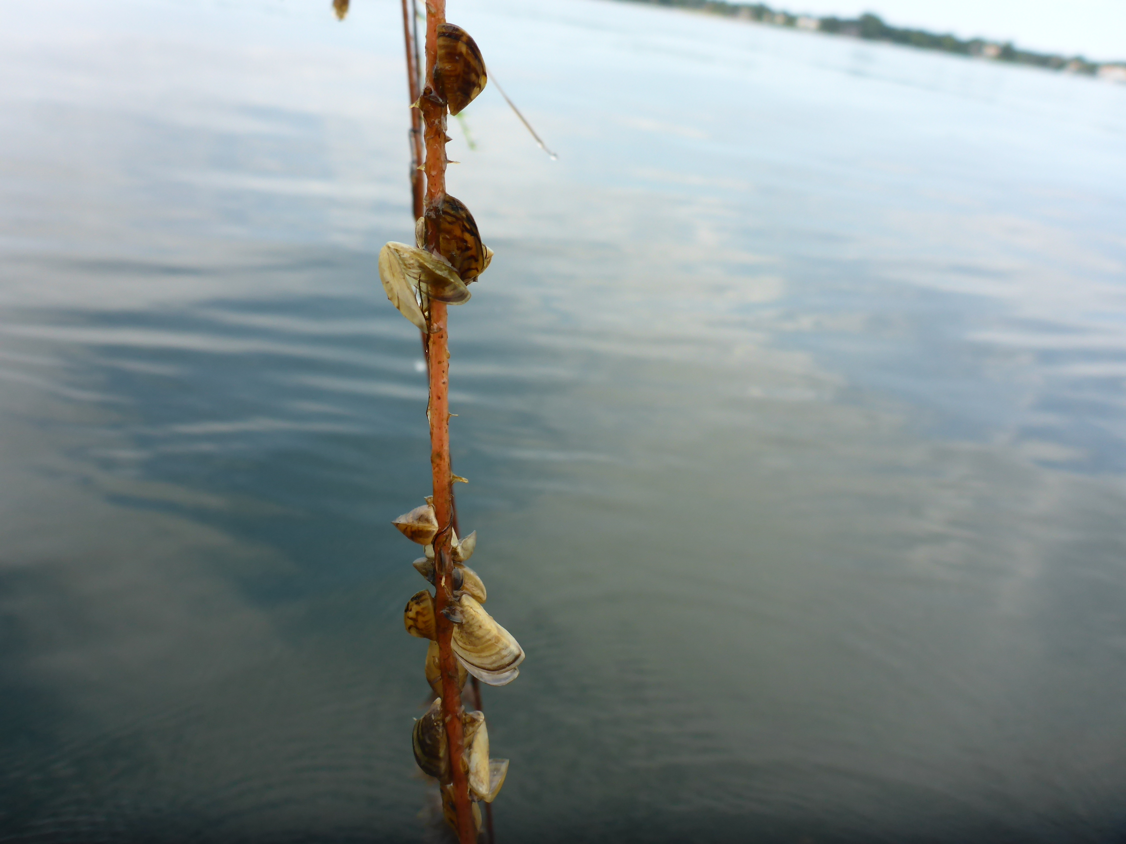
Zebra Mussel Distribution 2023 (First observed in 2014)

Slide 16
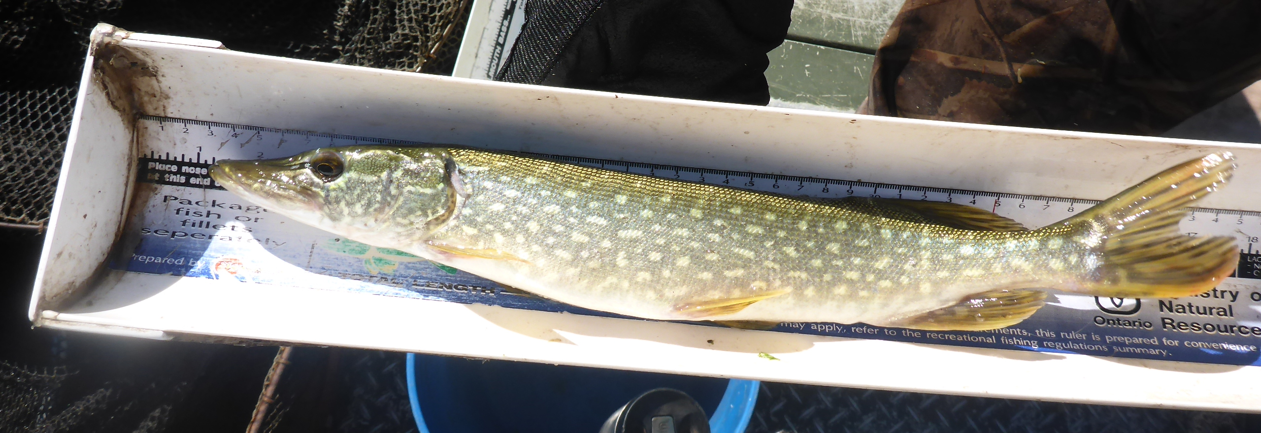
Fish Survey Results From 1954 to 2022
Year | Number of Species | Dominant Panfish | Dominant Gamefish
1954 | 15 | Yellow perch | Walleye
1975 | 17 | Bluegill | Northern pike
1979 | 17 | Bluegill | Northern pike
1984 | 17 | Bluegill | Northern pike
1989 | 14 | Bluegill | Northern pike
1994 | 17 | Bluegill | Northern pike
1999 | 15 | Bluegill | Northern pike
2004 | 19 | Bluegill | Northern pike
2008 | 13 | Bluegill | Northern pike
2014 | 18 | Bluegill | Northern pike
2016 | 14 | Bluegill | Northern pike
2018 | 15 | Bluegill | Northern pike
2022 | 14 | Pumpkinseed | Northern pike

Slide 17
2024 Summer Lake Use Study for White Bear Lake

Slide 18
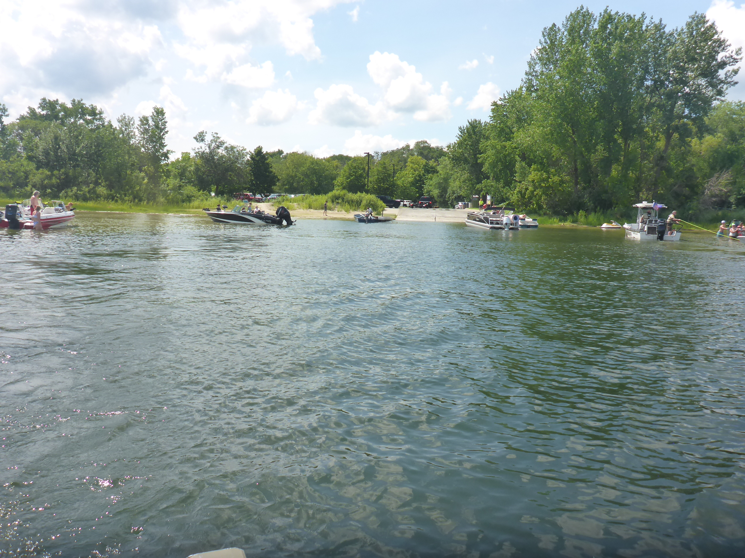
Data Collected for Lake Use
Shoreline watercraft and structure inventory
Launches from public access
Boat density observations on the lake
Homeowners Survey
Boaters’ Exit Survey

Slide 19
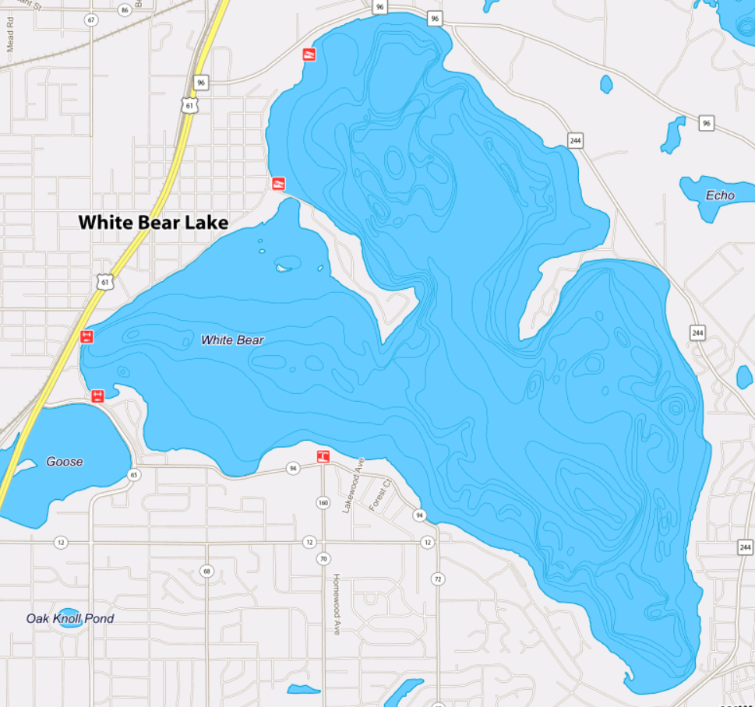
Public Accesses and Marinas
Ramsey County
Matoska Park
Accesses
(red dots)
Marinas
(green squares)

Slide 20
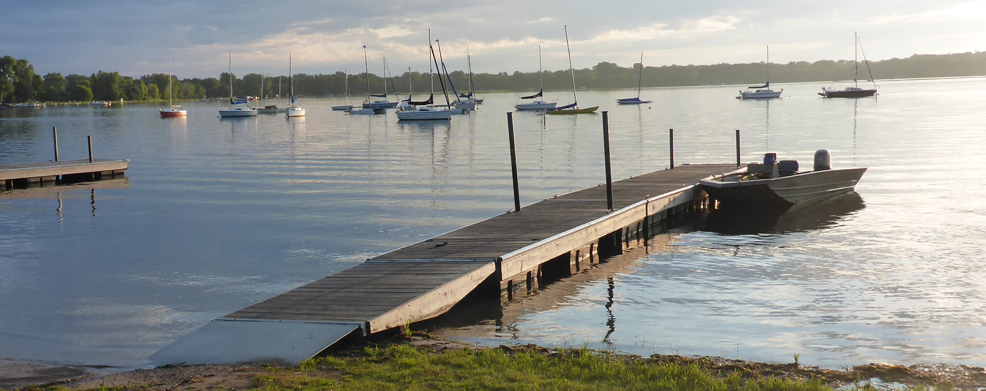
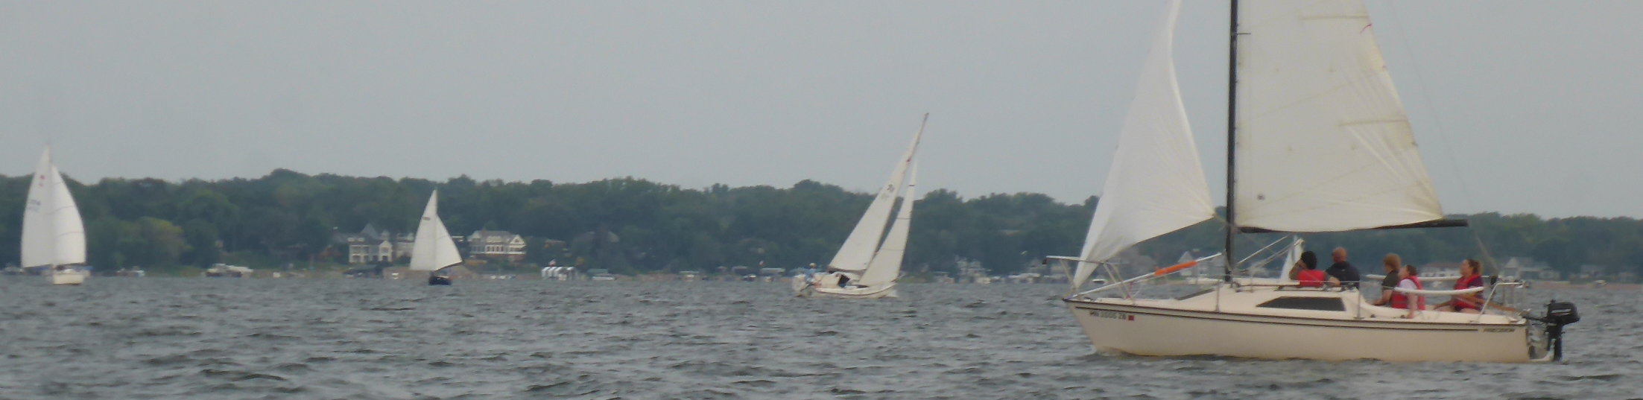
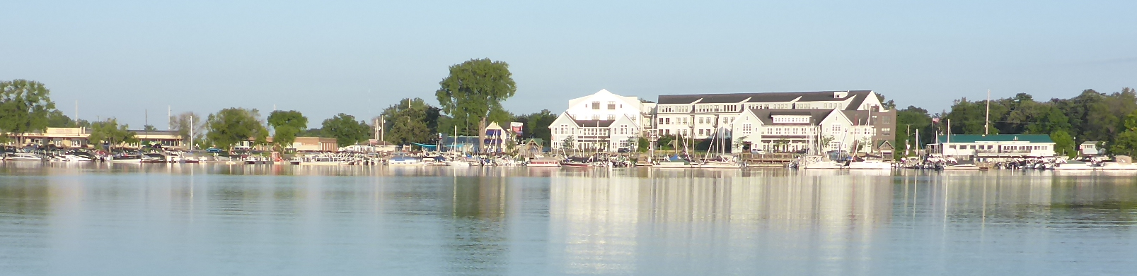
Three Marinas on WBL
Matoska Park
White Bear Yacht Club
Commercial Bay

Slide 21
Summer Boat Counts for WBL
Date | Lakeshore Power Boats and Sailboats | Lakeshore Kayaks, Canoes, and Paddleboards | Three Marinas Boats | Total
1999 | 809 | 91 | 524 | 1,424
2002 | 952 | 175 | 556 | 1,683
2004 | 901 | 179 | 545 | 1,623
2005 | 1,020 | 212 | 561 | 1,793
2008 | 922 | 233 | 570 | 1,725
2024 | 937 | 542 | 636 | 2,115

Slide 22
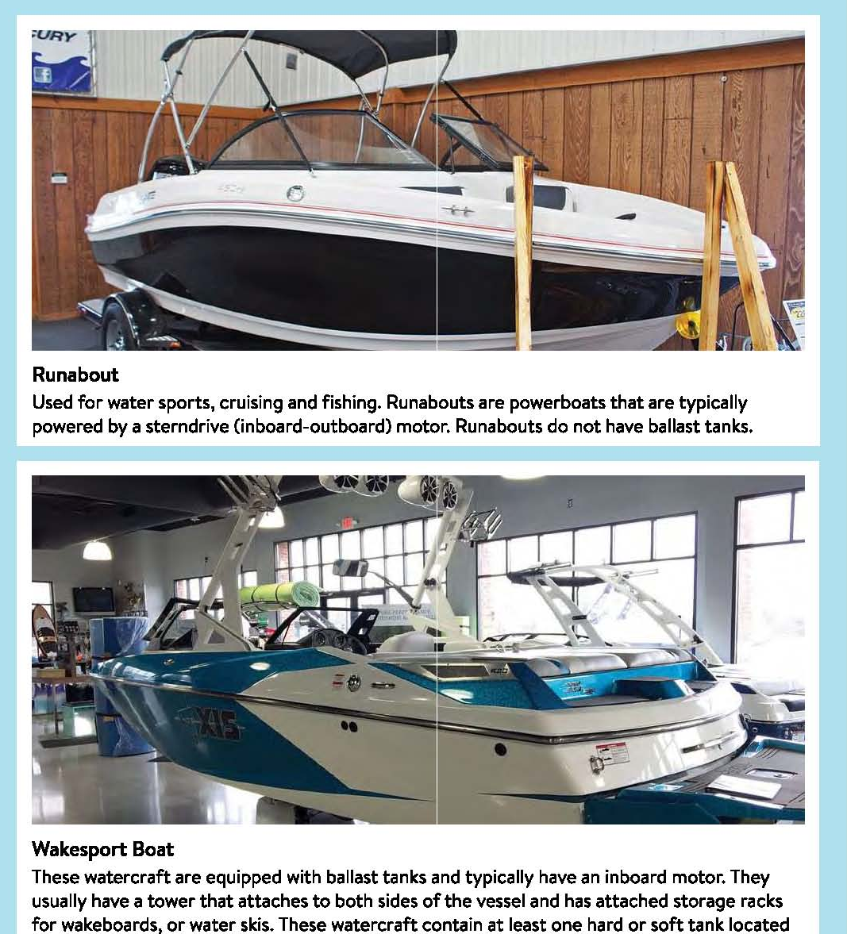
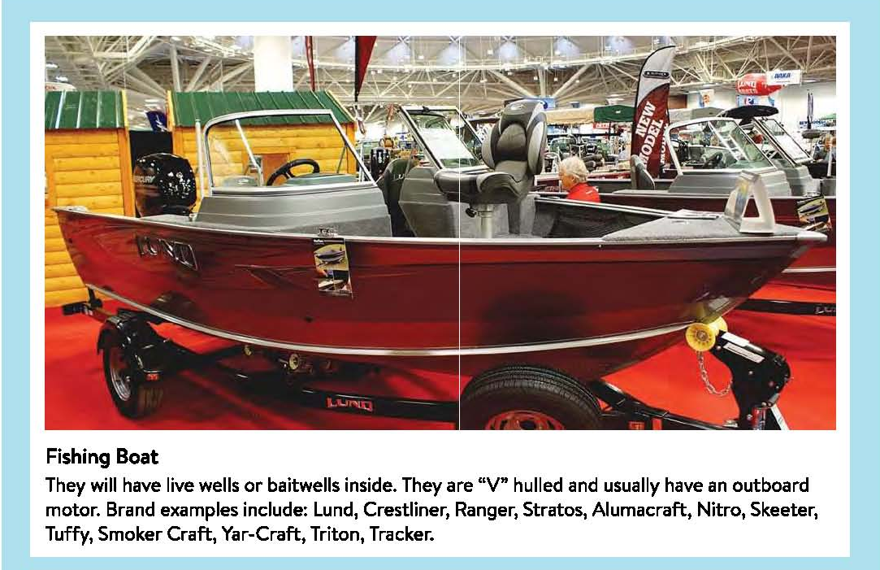
Boat Definitions Have Varied From 1999 to 2024
No ballast tanks
/ Waterski Boat
Typically, outboard motor or rear tiller
Ballast tanks, inboard

Slide 23
Watercraft Categories Used Over the Years
 | 1999, 2002, 2004, 2005, and 2008 Boat Categories | Shoreline Boat Inventory and Boat Density 2024
Fishing | A small open-hull boat with an outboard motor operated using a rear tiller. | Same as 2008 (rear tiller)
Runabout | Open or close-hulled boat with an inboard or outboard motor and a steering console. | Same as 2008. Includes wakesport boats.
Wakesport | No category in 1999 to 2008 | Included with runabout category.
Waterski | A boat pulling water skiers or specifically rigged for pulling waterskiers or tubers. Only used in boat density data | Tow boat actively pulling skiers, tubers, or surfers on the lake. Only used for boat density data.

Slide 24
WBL Shoreline Boat Inventory
Boat Type | Riparian Boat Inventory (residential and multiple docks)
 | 1999 | 2002 | 2004 | 2005 | 2008 | 2024 | Percent Change from 1999 to 2024
Fishing | 144 | 141 | 144 | 121 | 90 | 40 | -260%
PWC | 27 | 52 | 48 | 68 | 80 | 127 | +370%
Runabout | 267 | 354 | 343 | 400 | 336 | 318 | +19%
Sailboat | 179 | 195 | 156 | 180 | 157 | 82 | -54%
Pontoon | 175 | 197 | 189 | 230 | 248 | 368 | +110%
Canoe | 73* | 123* | 136* | 161* | 192* | 43 | -41%
Kayak |  |  |  |  |  | 349 | --
Paddleboat | 18 | 52 | 41 | 51 | 41 | 17 | -6%
Paddleboard |  |  |  |  |  | 133 | --
Sailboard | 6 | 13 | 15 | 10 | 0 | 0 | -100%
Other (mostly dinghy) | 11 | 0 | 6 | 11 | 11 | 2 | -450%
ALL CRAFT | 900 | 1,127 | 1,078 | 1,232 | 1,155 | 1,479 | +64%
(Human powered)** | (91) | (175) | (177) | (212) | (233) | (542)
POWERED BOATS AND SAILBOATS | 809 | 952 | 901 | 1,020 | 922 | 937 | +16%
* Category includes kayaks.
** Human powered = canoe, kayak, paddleboat, paddleboard, and sailboard.

Slide 25
Marina Boat Inventory
Boat Type | Commercial Bay |  |  |  |  |  | Matoska Park |  |  |  |  |  | WB Yacht Club
 | 1999 | 2002 | 2004 | 2005 | 2008 | 2024 | 1999 | 2002 | 2004 | 2005 | 2008 | 2024 | 1999 | 2002 | 2004 | 2005 | 2008 | 2024
Fishing | 16 | 1 | 12 | 1 | 12 | 10 | 29 | 37 | 40 | 39 | 32 | 6 | 4 | 3 | 3 | 2 | 2
PWC |  | 1 | 1 | 2 |  | 1 |  |  |  |  |  |  |  | 1
Runabout | 91 | 107 | 100 | 120 | 138 | 133 |  |  |  |  |  |  | 2 | 8 | 3 | 7 | 12 | 10
Sailboat | 170 | 172 | 155 | 152 | 119 | 36 | 36 | 36 | 28 | 32 | 44 | 23 | 27 | 20 | 24 | 24 | 22 | 52
Pontoon | 113 | 137 | 150 | 147 | 149 | 304 |  |  |  |  |  |  |  | 2 |  |  |  | 6
Canoe | 20 |  |  | 7 | 3 |  | 12 | 20 | 14 | 15 | 20 | 17 |  | 1 | 2 | 2 | 11
Kayak |  |  |  |  |  | 8 |  |  |  |  |  | 14
Paddleboat |  |  |  |  |  |  |  | 1 | 1 |  |  | 1 |  | 1
Paddleboard |  |  |  |  |  | 4
Other (mostly dinghy) | 2 |  |  |  |  |  | 2 | 4 |  |  | 4 | 11 |  | 4 | 12 | 11 | 2
TOTALS | 412 | 418 | 418 | 429 | 421 | 496 | 79 | 98 | 83 | 86 | 100 | 72 | 33 | 40 | 44 | 46 | 49 | 68
(Human powered)* | (20) |  |  | (7) | (3) | (12) | (12) | (21) | (15) | (15) | (20) | (32) |  | (2) | (2) | (2) | (11)
* Human powered = canoe, kayak, paddleboat, and paddleboard

Slide 26
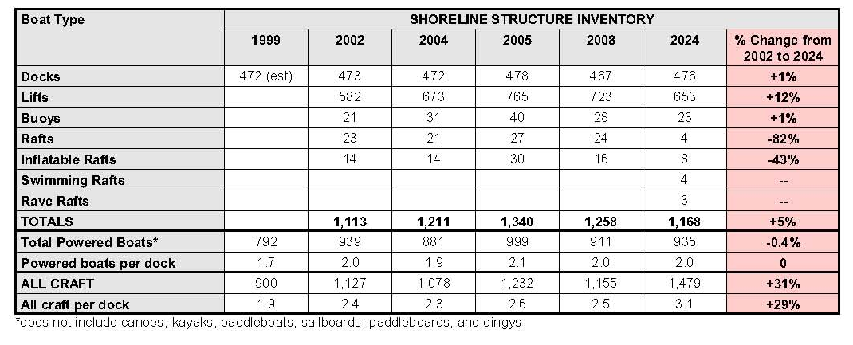
Shoreland Structure Inventory

Slide 27
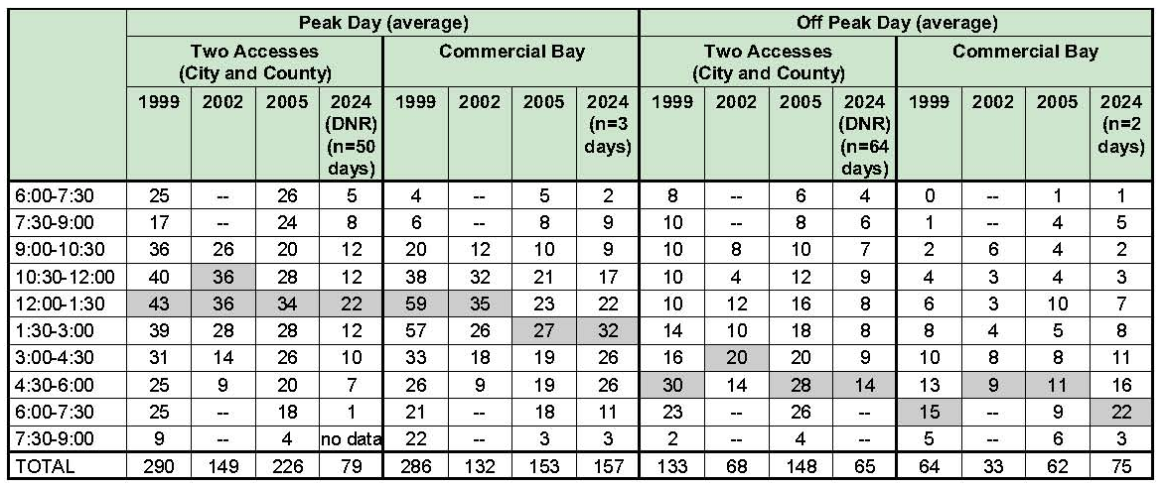
Boat Launches from Two Accesses and Commercial Bay

Slide 28
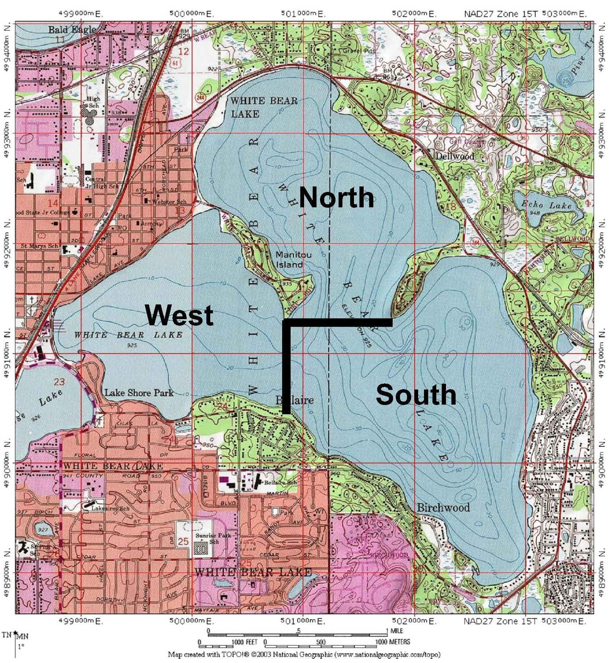
Three Lake Bays Used for Boat Density Observations

Slide 29
Boat Density on White Bear Lake (Maximum number of boats of a daily 1.5 hour time interval average)
 | 1999 |  | 2005 |  | 2024 |  | 1999 |  | 2005 |  | 2024
 | Peak (3 days) |  | Peak (3 days) |  | Peak (3 days) |  | Off-Peak (3 days) |  | Off-Peak (3 days) |  | Peak (3 days)
 | # of boats | ac/ boat | # of boats | ac/ boat | # of boats | ac/ boat | # of boats | ac/ boat | # of boats | ac/ boat | # of boats | ac/ boat
North Bay (739 ac) | 75 | 10 | 46 | 16 | 67 | 11 | 26 | 28 | 35 | 21 | 26 | 28
South Bay (1,036 ac) | 60 | 17 | 57 | 18 | 37 | 28 | 30 | 35 | 22 | 47 | 33 | 31
West Bay (645 ac) | 41 | 16 | 40 | 16 | 32 | 20 | 20 | 32 | 23 | 28 | 21 | 31
Whole lake (2,420 ac) | 176 | 14 | 143 | 17 | 136 | 18 | 76 | 32 | 80 | 30 | 80 | 30
Boat density of less than 20 acres/boat is a concern.

Slide 30
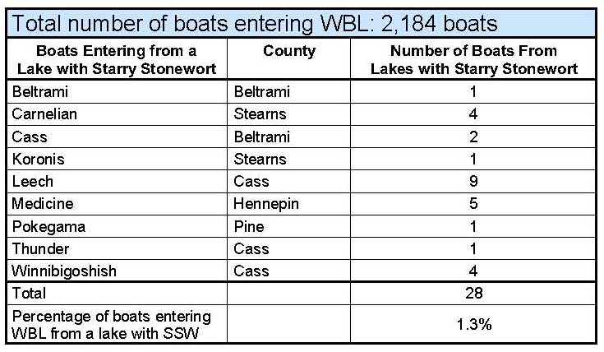
MnDNR Boat Inspections and AIS

Slide 31
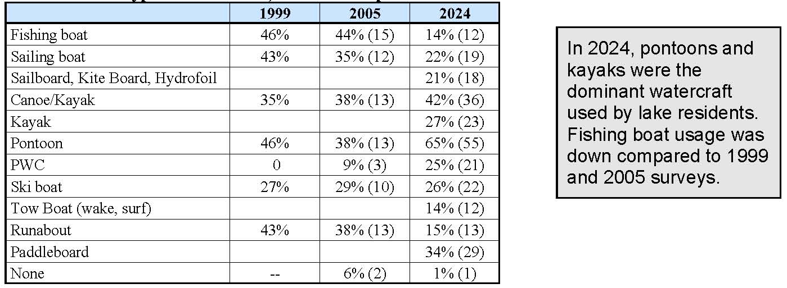
Lake Resident Questionnaire: Boat Use

Slide 32
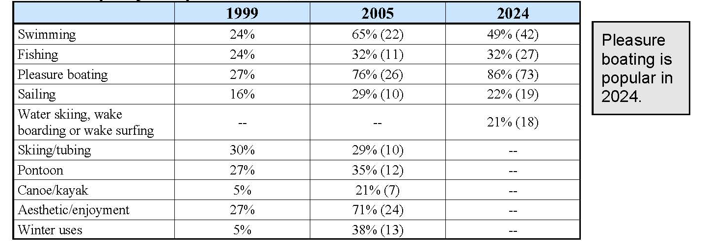
Lake Resident Questionnaire: Primary Activities on WBL

Slide 33
2024 Boater Exit Surveys (42 responses)
Average time on the lake was 3 hours.
Average number of times visiting WBL in a season was 17 visits.
In early morning responses, the primary activity was fishing. Recreational boating dominated in the afternoon.

Slide 34
2024 Lake Homeowner Surveys (85 responses)
15% of the respondents have lived on WBL for 40 years or more.
Dominant watercraft usage are pontoons, kayaks, and paddleboards.
Lake residents use the lake an average of 3 times per week.
Main lake use by lake residents is pleasure boating.
81% of the respondents find the lake was crowded on weekends.

Slide 35
CONCLUSIONS AND RECOMMENDATIONS (1/3)
Existing ordinances for offshore no-wake buffers of 200 feet from shore are adequate pending more information of impacts of surf wake boats.
The density of surf wake boats on WBL was relatively low in 2024, with not more than 2 wake-surf boats in a bay at any time period during the 6 days of lake observations which includes four 15-hour peak days.
As more research becomes available on lake impacts from boating activities, the WBLCD should incorporate latest research findings as it applies to White Bear Lake into revised regulations.

Slide 36
CONCLUSIONS AND RECOMMENDATIONS (2/3)
Commercial Bay marina may be nearing build-out, meaning additional new dock spaces will be minimal.
Navigation in Commercial Bay is at slow speeds. In contrast boating density on the open water of the whole lake is generally safe based on MnDNR criteria 20 lake surface acres per boat. However, on peak days, there are several afternoon hours, especially in the North Bay, where boat densities are less than 20 ac/boat.
It is suggested when boat access inspectors are present at the landings, they could remove aquatic plants by raking out plants at the access. In 2024, 22% of boats leaving the access had aquatic plants on the trailer. Zebra mussels could be attached to the plants.
MnDNR boat inspection records should be reviewed annually to determine the frequency of visits to WBL from lakes with AIS, such as starry stonewort and spiny waterflea, that are not currently in WBL.

Slide 37
CONCLUSIONS AND RECOMMENDATIONS (3/3)
The White Bear Lake shoreline has very few vacant lots so new development is minimal. Most residential construction is redevelopment.
Since the number of homes is not increasing, the number of docks and the number of powered boats have not significantly increased since the 2002 survey.
The number of boat trailer parking spots in the two primary public accesses have remained the same since the lake use survey in 2002.
It appears boat-powered lake density has not changed significantly in the last 20 years, although boat horsepower has increased.
The most dramatic changes in lake use on White Bear Lake have been an increase in pontoons, kayaks, and paddleboards, and a decrease in sailboats and rear-tiller fishing boats. Wakeboats are more common compared to the last survey in 2005 and raise safely concerns based on questionnaire survey responses. Similar concerns of power boat impacts were registered in the previous questionnaire survey from 2005 as well.

Slide 38


Slide 39
Rice Creek Watershed District
(RCWD)
Watershed Technician: Ali Chalberg
Mini grants:
Go to our website:
www.ricecreek.org

